Slide 1
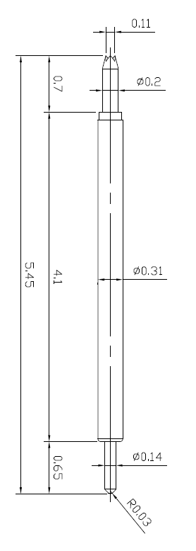
※ High speed POGO pin – 2.0mm / 0.4P
IVB-SAR-545-031-A243-00
1. General info.
Pitch | 0.4mm
Total Length | 5.45mm
Use Length | 5.05mm
Use stroke | 0.4mm
Spring Force at Use Stroke | 18gf at 0.4mm Stroke
Operating Temperature | -40 to 200°C
DC Resistance | Avg. 85.0mΩ
Current Rating (Continuous) | 6 A
Self Inductance | 1.00 nH
Bandwidth @ -1dB | 18.6 GHz
Insertion Life | 100,000 cycles
2. Current info.
Duty ratio | On | Off | Max current (A)
1.0 | Continuous |  | 6.0
0.5 | 0.1 sec | 0.1 sec | 8.5
0.1 | 0.1 sec | 0.9 sec | 12.0
0.01 | 0.1 sec | 9.9 sec | 14.0

